Slide 1
FASHION ICONS WITH THEIR DRESSES
BY-ADVITYA BHATIA

Slide 2
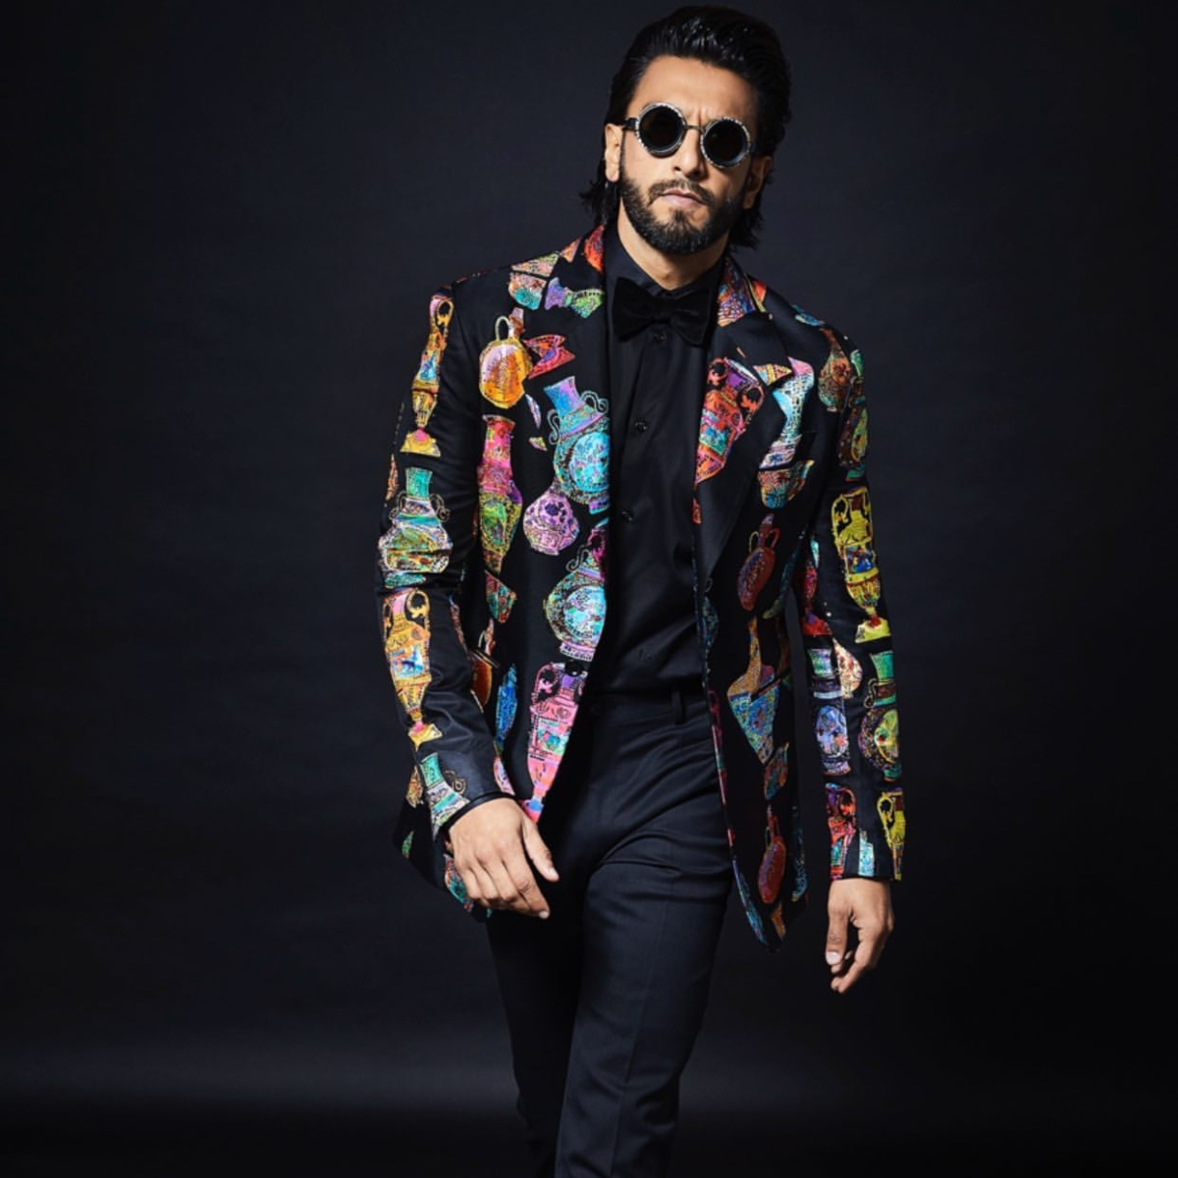
RANVEER SINGH
RANVEER SINGH IS ONE OF THE MOST ACTIVE PEOPLE OF BOLLYWOOD AND HE ALSO LIKES TO DRESS UP IN DIFFERENT TYPES OF CLOTHES .IN MOST SHOWS HE DRESSES IN SUITS ,HE ALSO LOVES TO WEAR COLOURFUL DRESSES LIKE YOU CAN SEE IN THE PICTURE .HE IS WEARING A SUIT WITH A COLOURFUL AND PRETTY COAT AND HE IS LOOKING QUITE HANDSOME .HE LIKES TO WEAR WATCHES AND GLASSES AS WELL .HE WEARS CASUAL CLOTHES AT HOME LIKE A SIMPLE T-SHIRT.

Slide 3
HRITHIK ROSHAN
HRITHIK ROSHAN IS ANOTHER RENOWNED ACTOR OF BOLLYWOOD AND HE MOSTLY LIKES TO WEAR A SIMPLE T-SHIRT WITH A JACKET AND A TROUSER AS YOU ALL CAN SEE IN THE PICTURE .HE LOOKS GREAT IN SUITS AS WELL . MOSTLY HE WEARS CASUAL CLOTHES .IF WE TALK ABOUT HIS ACCESSORIES ,HE LIKES TO WEAR GLASSES AND A CAP AS SHOWN IN THE PICTURE.

Slide 4
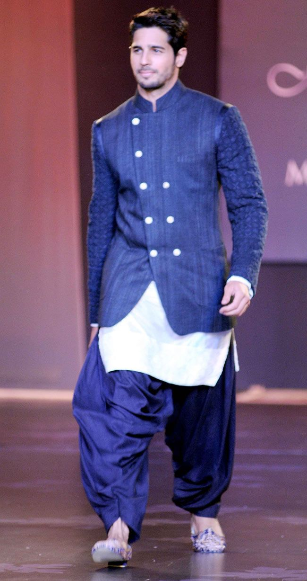
SIDHARTH MALHOTRA
HE IS SIDHARTH MALHOTRA WEARING A BLUE COLOURED KURTA .HE IS LOOKING REALLY HANDSOME .HE SOMETIMES WEARS TRADITIONAL CLOTHES AND MOSTLY LIKES TO WEAR A SUIT WITH A SIMPLE WATCH. HE REALLY CARES ABOUT HIS HAIRSTYLE AND BEARD.

Slide 5
DEEPIKA PADUKONE
DEEPIKA PADUKONE IS WIFE OF RANVEER SINGH . SHE LIKES TO WEAR TRADITIONAL CLOTHES AS SHOWN IN THE PICTURE .SHE ALWAYS WEARS A NEW PAIR OF EAR-RING TO LOOK PRETTY. ALL COLOURS OF TRADITIONAL CLOTHING SUITS HER.SHE ALWAYS DRESSES TO KILL AND IS SEEN MOSTLY IN TRADITIONAL CLOTHES ON FESTIVALS.

Slide 6
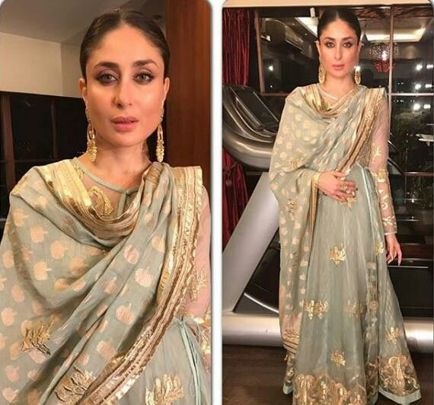
KAREENA KAPOOR
KAREENA KAPOOR IS WIFE OF SAIF ALI KHAN AND SHE ALSO LIKES TO WEAR TRADITIONAL CLOTHES .THOUGH SHE LOOKS GOOD IN CASUAL CLOTHES, BUT SHE IS MOSTLY SPOTTED IN TRADITIONAL CLOTHES ON FESTIVALS. SHE LIKES WEARING TRADITIONAL EAR-RINGS THAT COMPLIMENTS HER DRESS .

Slide 7
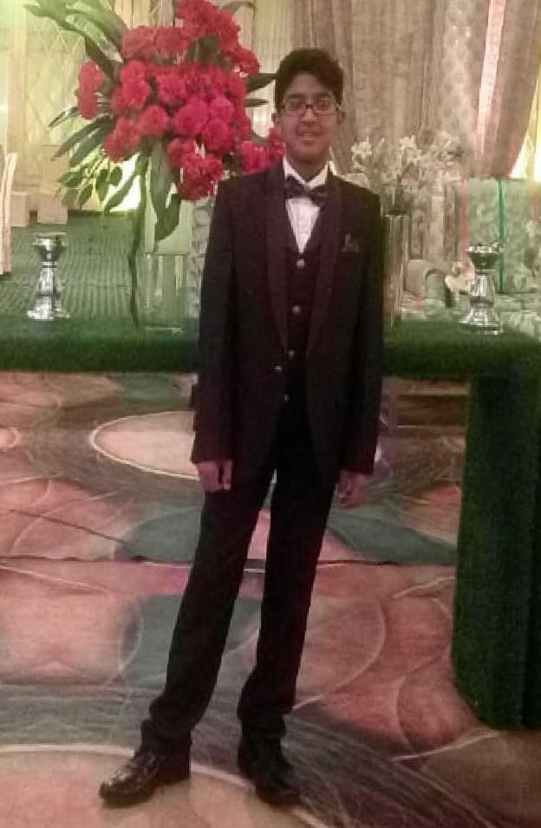
ADVITYA BHATIA
THIS IS MY PHOTO . I BOUGHT THIS DRESS FOR MY UNCLE’S WEDDING . ONE FINE DAY , I WENT TO SECTOR-17 , CHANDIGARH FOR SHOPPING TO BUY A NICE ATTIRE FOR THE FAMILY WEDDING.
AFTER A LOT OF SEARCHAT ONE SHOP I SAW THIS REDDISH-MAROON COLOURED SUIT AND I THOUGHT THAT IT WAS JUST THE PERFECT ATTIRE. I BOUGHT THIS SUIT . THIS SUIT IS ONE OF MY FAVOURITE DRESSES AS I LOOK SMART AND HANDSOME. HOWEVER DURING THE LOCKDOWN IT IS JUST HANGING IN MY WARDROBE .

